Slide 1


Bonsai On A Budget
Alex Labram
October 2025
Nemeta Bonsai
nemeta.co.uk

Slide 2
Learning Outcomes
Theory
Be aware of the history and culture of bonsai
Understand (at a high level) how a bonsai is produced
Understand (at a high level) what distinguishes good and bad bonsai
Know how to maintain a bonsai on a day-to-day basis
Experience the key activities of re-potting, pruning and wiring
Be aware of inexpensive options for further learning and practice
Practical
Watering bonsai
Wiring a bonsai pot for re-potting
Exposing the nebari
Potting the prepared tree
Pruning for bulk, congestion and taper
Wiring for shape

Slide 3
Recap
What You Should Remember From Yesterday

Slide 4

Bonsai: Art & Science
Good bonsai practice is:
Authentic - makes you think “tree”
  Tree as biological / ecological process
Dramatic – makes you think “TREE”
  Tree as compositional element
Pragmatic – doesn’t make you think “dead tree”…
  Tree as living clay

Slide 5
I Had One Once, But It Died
What a bonsai needs to survive
Environment
  Indoor vs Outdoor
Watering!!!!!
  Single biggest killer of bonsai
  “Root hairs” die easily in drought
  Over-watering is also dangerous!
Light
Heat
  Dormancy
Airflow
Pest Control
  Animals: spider mites, scale bugs, aphids, caterpillars, vine weevil, squirrels
  Plants etc: pearlwort, liverwort, wood sorrel, pennywort, nostoc
  Caution: environmental issues!
Fertiliser
  “Balanced”: roughly even NPK
  Organic => micronutrients
  Caution: environmental & ethical issues!
Bonsai are far harder to keep alive than most common pot plants!

Slide 6
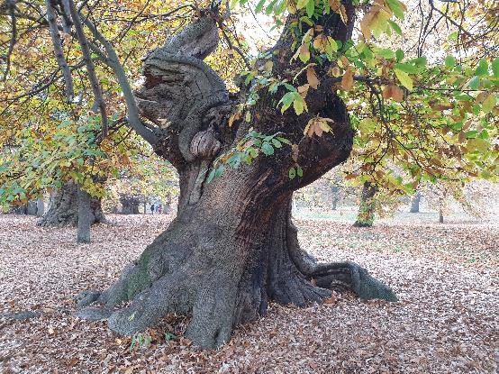
Authenticity & Age
What makes a tree look mature?
Canopy shape
  Rounded triangle
  Composed of rounded-triangle “pads” (for species that back-bud less readily)
Trunk & branch behaviour
  Short inter-node distance
  “Ramification”: fractal splitting of branches
  “Square-cube law”: big tree = proportionally heavier load = more curvature
  “Ruptures”: jagged direction changes
Texture
  Bark
  Dead-wood: advanced bonsai topic!
Taper
  “Nebari” (根張り) = root flare / buttress
  Trunk & branch flare: from base to apex / tip
  Trunk-to-branch (and branch to sub-branch) ratio

Slide 7
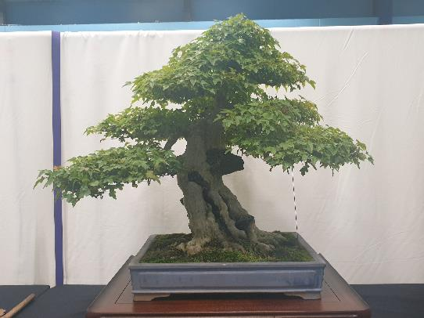
Drama & Perspective
What makes a tree stand out?
Taper (again!)
  Taper appears stronger from viewpoint at base of tree
Pot: picture-frame for tree
  “Heavy” earthenware vs “light” glazed
  Depth ≈ trunk thickness; width ≈ 2/3 canopy height (tall tree) or width (wide tree)
  Style: heavy vs light, plain vs ornate
Use of negative space
  …Often in imitation of wind-flow or trunk death in full-scale trees
Scaled-down decorations
  Moss “grass”, accent plants, rocks (“suiseki”)
Well-defined “front”
  Style is firmly established
  Sense of strength or movement captured
  Clear view of lower trunk
  No crossed branches
  Tree’s “centre of mass” is in middle of pot

Slide 8
Pragmatism 2
Making Life In Miniature

Slide 9
Bonsai Lifecycle
Sources
Training
Refinement
Slow
Seeds
Cuttings
Fast
Garden centre seedlings
Scavenging
Pot-ready
“Nonsai”
Garden centre mature trees
Yamadori
Display
Exhibition
Photography
On-boarding
Grow out
Re-pot
Prune
Wire
Cut back
Major intervention
Restyling
Air layering
Deadwood
Dead ☹

Slide 10
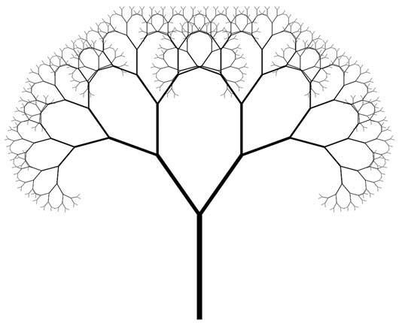
Why We Prune
It’s not just repressed sadism, honest
Shape the tree
  “Structural” pruning to shape trunk + primary branches and fit a bonsai style / archetype
  Canopy pruning to create rounded-triangle shape(s)
Shape the branch - encourage ramification and taper
  Encouraging lateral growth by removing terminal / apical buds
  Continuing the ramification process past the eye’s limits makes
  judging scale difficult and creates the illusion of great size
Pick winners - before the tree can pick for us!
  Improve spacing and remove congestion and “fluff”
  “Balance energy”: force growth away from the apex towards more interesting (to us) areas
Crowd management - reduction of green mass
  Let light through to lower areas of the tree (pruning for “inner growth”)
  Reduce water shock when re-potting

Slide 11
Botany & Pruning (1)
Not all trees are alike
Apical
Types of growth
  Apical growth from the tip of the trunk
  Terminal growth from the tip of branches
  Lateral growth from behind the tip
  Adventitious growth from the base of branches
  Epicormic growth from random spots on the trunk
Back-budding (adventitious + epicormic*): Weak back-budding → we have to plan further ahead (e.g. leave sacrificial branches) to thicken the trunk
Lateral growth: Dense lateral growth → we have to think in terms of zones along each branch instead of looking at individual sub-branches
Apical dominance: Some trees (conifers especially) grow more strongly upwards
Flushes per year: Usually two (Spring and Lammas) except for mountain-growing pines
Terminal
Lateral
Adventitious
Epicormic
* Warning: botanists use “back-budding” to mean something different!

Slide 12
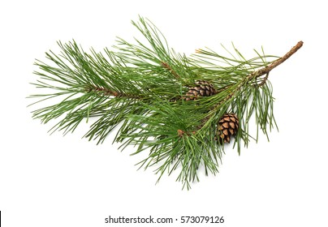
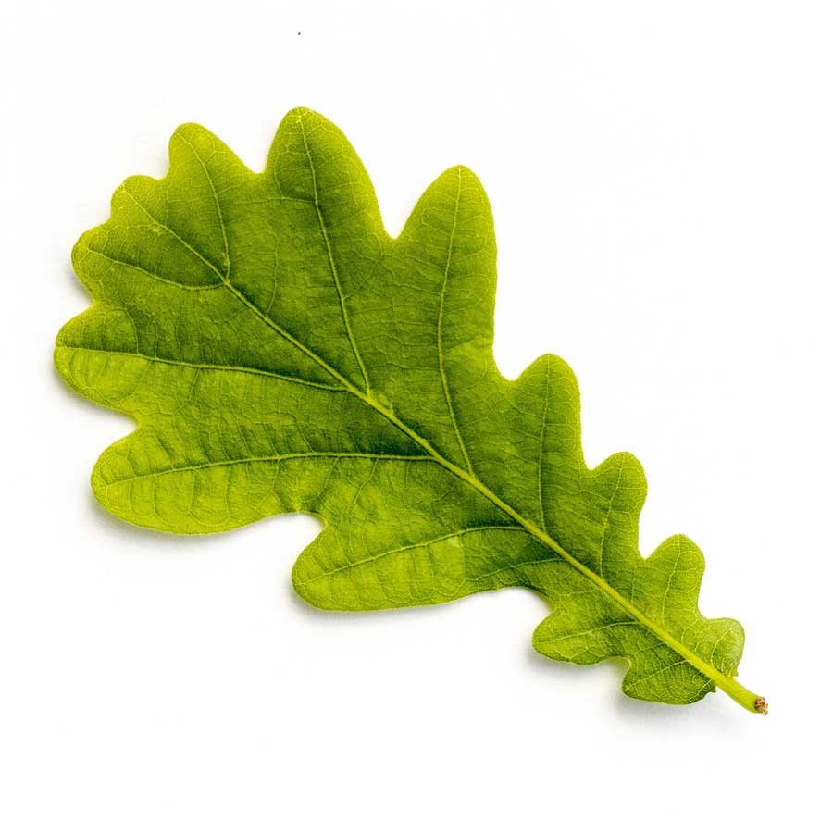
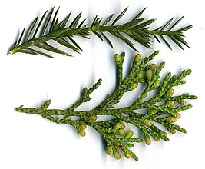
Botany & Pruning (2)
Three main types of foliage
Needle-bearing
Broadleaf
Spiky / scaly

Slide 13
Structural Pruning
Building a solid foundation
Goals
Select an appropriate style for the tree
Identify and establish the trunk and first few branches of the bonsai
Mark out sacrificial branches to thicken the trunk / nebari
During the tree’s “training” phase: make the most of fast woody growth
Create a base for subsequent development of smaller branches and canopy
Approach
Start from the base
Clear branches from the lower trunk
  Or mark for later removal, in which case remove all side-growth to avoid wasted energy
Working up the tree, at each node remove all but two branches

Slide 14
Pruning for Ramification (1)
Broadleaf trees: playing in easy mode
Context
Can handle loss of mass
Back-buds readily
Leaves may be simple or compound,
alternating or opposite
Goals
  Reduced bulk of foliage
  Minimal wasted growth
  Strong taper along branch
Approach
  Once a branch is well-established, cut it back to “two heirs and a spare” (at least)
    The spare is a sacrificial branch: it can be removed later if the heirs survive
    One sub-branch will become the new “leader”; the other will be a side-branch
Allow to
grow out
Repeat for
each new
branch
Pinch off tip
Wait for buds
to burst
Wait for buds
to burst
Cut back
to 3 nodes*
* Or 2 nodes (4 buds) for opposite leaves

Slide 15
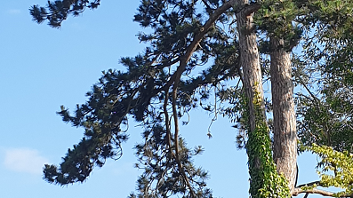
Pruning for Ramification (2)
Needle-bearing trees: getting trickier
Context:
No epicormic growth
No lateral growth from old (needle-less) wood
Often weak adventitious growth
Often strong apical dominance
Goals
Green growth should form pads / clouds or layers, floating above the branch
Remove needles from trunk and base of branches to create old wood and permanently restrict future growth
Control apical growth carefully to stop premature die-off of lower branches (“energy balancing”)
Cutting back tips (removing current-year terminal growth) is called “de-candling”
Approach
Create ramification and taper following the same process as for broadleaf trees
…but leave some lower branches as sacrificial branches to thicken the trunk
Be sure that each new branch has some foliage at its tip, or it will die
Don’t panic if you have long branches without side-shoots: these can be made more compact by wiring!

Slide 16
Pruning for Ramification (3)
Spiky / scaly trees: super fiddly
Context:
No epicormic growth
Lateral growth is already present!
Short inter-node distance
Spiky foliage = immature scaly foliage
Goals
  Green growth should form pads or layers along the branch
Branches should form fractal “fishbones”
Approach
Remove branch tip (Zone D) entirely;
Remove growth out of the layer (i.e. up or down if branch is horizontal)
Remove growth in Zone A;
Thin out growth in Zone B;
Shape-prune growth in Zone C
…Then repeat for each branch in Zone B
6
3
5
1
6
4
A
B
C
D
A
B
C
4
6
3
5

Slide 17
Wiring
The rules guidelines
Goals
Imitate the effect of gravity on full-size tree branches (“square-cube law”)
  Make straight branches look like they’re the product of many shorter segments
  Spread branches to avoid shading each other
  Fill unwanted gaps in the canopy
  For conifers: bring foliage closer to trunk
Approach
If it’s daft and it works, it’s not daft
  We use anodised aluminium wire because it is easy and attractive. Weights, strings, corks, rubber bands, etc are all completely valid alternatives!
  Use the thinnest gauge of wire that will still bend the branch
  E.g. if either 2mm and 1.5mm would work, but 1mm wouldn’t, use 1.5mm
Always wire two branches together!
  …Or wire a branch to the trunk, or the trunk to the root ball / pot; just don’t try to wire a single branch on its own
Wire at 45º to the branch / trunk
  Rule of thumb: the wire needs to be the length of branch / trunk to be wired × 1.5
The wire is a cage not a corset
  I.e. use as little pressure as possible: the less it digs in on Day 1, the longer you have before it leaves wire-marks on the bark
  It’s OK to leave an “open coil” spiral at the end to gently control green growth
Leave wire on for one growth season
  Usually 6 months – covering either Spring or Lammas growth - except for some mountain pines which only have one growth flush per year
  If the branch hasn’t “set” after one flush, you just have to reapply the wire

Slide 18
Stress Management
…No, I meant for the tree
Sources of water stress
Root pruning
Under-watering
Over-watering / poor drainage → root rot
Over-fertilising
Summer
Sources of wood stress
Heavy removal of green growth
Branch removal past the “collar”
Some kinds of deadwood work
Insect attacks
It’s best to space stresses out over as much time as possible – e.g. 1 major stress per tree per growth season
Water stress and wood stress are not (necessarily) additive: if you prune the foliage and the root ball, there is less demand for water so less work for the remaining roots

Slide 19
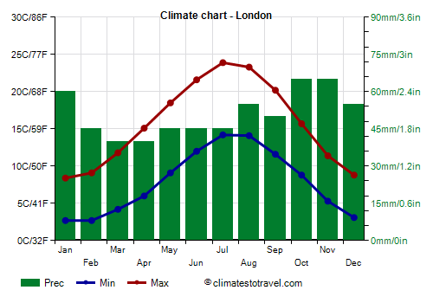
There Is A Season
When to do what
Winter
Spring*
Summer
Autumn
Dormancy
Light watering
Frost protection**
Cleaning & tidying
Stock up on growth media
Spring growth
Moderate watering
Moderate fertilising
Pest control & weeding
Re-potting (every 1-3 years)
Structural pruning if needed
Wiring / wire removal
Sun & heat
Heavy watering***
Very light fertilising
Enough shade (species dependent)
Lammas growth
Moderate watering
Mild fertilizing
Pest control & weeding
Pruning for ramification
Wiring / wire removal
* Spring for bonsai practitioners (especially in London) typically starts earlier than the calendar date
** Not usually needed in present-day London due to the heat island effect and global warming
*** If going on holiday, put bonsai in bath with enough water to just barely touching the soil through the pot drainage holes

Slide 20
Next Steps
Becoming a Bonsai Practitioner

Slide 21
Practice, Practice, Practice
Practice, practice, practice, practice… you get the picture
Keep your tree alive and bonsai-ish
  Remember: WATERING!!!
  Remove wire in ~6 months
Find rogue seedlings to “adopt”, and transfer them to pots
  …Without killing them, I mean
  Once you’re sure they won’t die, prune them and gradually move them to smaller / shallower pots
Start to build a bonsai toolkit
  Start with cheap / improvised tools: chopsticks, pliers, wire-cutters, tamper, nail scissors
  Consider buying: root shears, straight-edged branch cutter
Build a collection of pots for all bonsai styles and phases of development
  Make your own – e.g. with crockery and a diamond tile hole saw
Contemplate trees in nature
  What principles do they reflect, and how did they get that way?

Slide 22
Learn From Others
Apart from yours truly
Buy a book
  I like the DK Bonsai book: https://www.dk.com/uk/book/9781409344087-bonsai/
UK Bonsai Association: https://www.ukbonsaiassoc.org
Local clubs
  Currently none in central London, but several out in the suburbs
  The UKBA site has a very complete list (albeit not the easiest to search)
Bonsai shows and car boot sales
  Again: the UKBA has a calendar
  Again: none in central London, but some in Twickenham, Bracknell, Kent…
Youtube
  Channels: Mă-Kè Bonsai, Herons Bonsai, Bonsaify, Notion Bonsai, Bonsai Empire, …
Drop me an email! alex@nemeta.co.uk

Slide 23
Thanks For Attending!

Slide 24
Appendices
Miscellaneous Technical Notes

Slide 25
Woody Plants: A Family Tree
Evolution From A Bonsai Pruner’s Perspective
Prune as:
  Broadleaf
  Needley conifer
  Spiky / scaly conifer
  Special case
B
N
S
!
Vascular
plants
B
Gymnosperms
(“Naked Seed”)
Angiosperms
(“Covered Seed”)
Magnoliids
!
Gingko
B
B
Pinaceae
(“Pine-like conifers”)
Cupressaceae
(“Cypress-like conifers”)
Asterids
Rosids
N
Pine
B
Yew
“True” Cypress
S
Ash
(Crab) Apple
Oak
N
B
S
Spruce
Redwood
Juniper
Elder
Elm
Maple
N
S
S
“True” Cedar
Sugi
“False” Cedar
Rhododendron
Prunus:
Cherry, Plum, Apricot, etc
Lime
N
Beech
Larch
Azalea

Slide 26
Repotting step-by-step
✓
fingers
Regular repotting – often back into the same pot! - helps limit tree size via “root-to-shoot ratio”
1. Prepare pot
Pick a (tentative) pot
Scrub clean
Staple mesh over holes
Add guy wires
2. Prepare tree
Remove from pot
Clean off soil surface
Dig down to expose nebari
Choose “front” if not already clear
Dig up / in to define root-ball
Untangle lateral roots where poss. (esp. girdling roots)
Clear any growth from lower trunk
Spray with water if starting to dry!
3. Insert tree into pot
Add shallow layer of soil to base
Place root ball in pot and pack soil around
Compress soil to “brownie” hardness
Pull guy wires over root ball, twist pairs together tightly, and trim to 3-4 twists
Cover with dried, grated, rehydrated sphagnum and compress surface
Sprinkle with grated acrocarpous (upward-growing) moss
✗
Prone to snapping!
✗
Prone to snapping!

